Slide 1
Zambia Zero-Waste Zero Landfill - Four WTEG Power Plants
USD $350 Million
Alset Zero Waste Zambia Limited & Alset Power Company, Inc.
Website: wtezambia.com

Slide 2
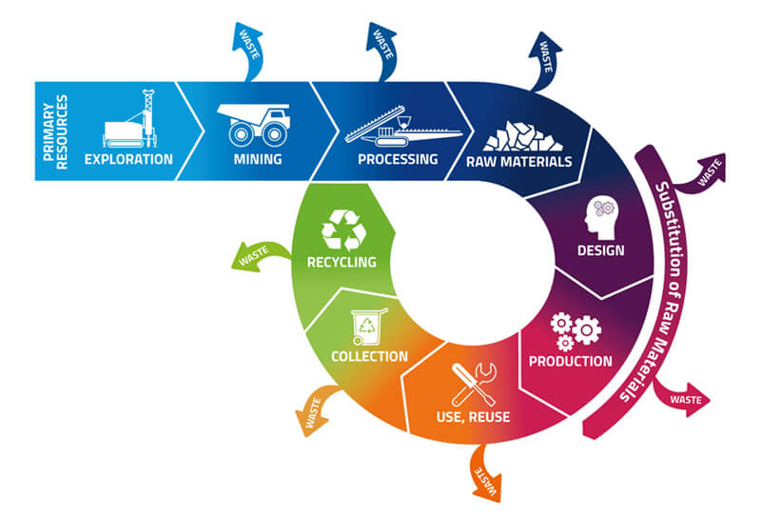
Circular Economy Transition
Zambia produces 2,000 tonnes MSW per day
Gasification Energy Plants ZERO Waste ZERO Landfill & 100% Recycling. This is not Incineration this is 100% Recycling of glass, metals, ash and ceramics, & producing Syngas from Gasification to produce electricity.
Plastic is used in the Gasification process to produce much needed clean electricity. Very, very low emissions and 45% more efficient than Incineration.
Four new Net Zero Waste plants & trucks for Leopard's Hill, Livingston, Monze & Lake Tanganyika Harbour areas in Zambia.
Zero Waste – Zero Landfill – all waste is used Four new waste plants

Slide 3
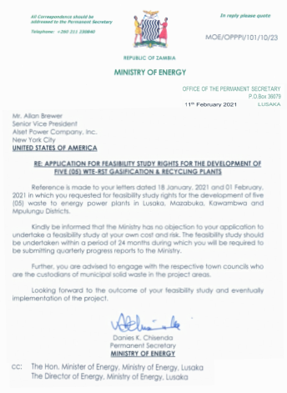
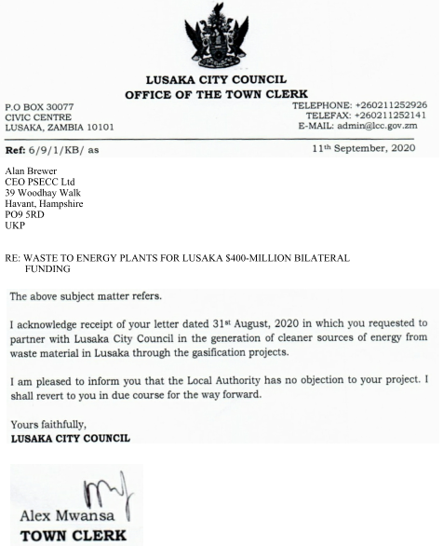
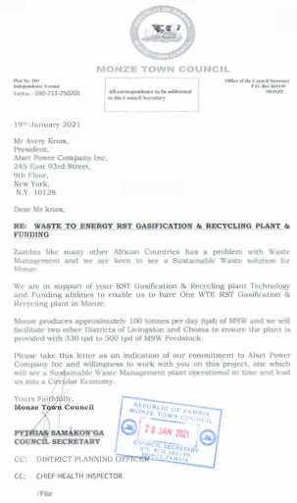

Slide 4
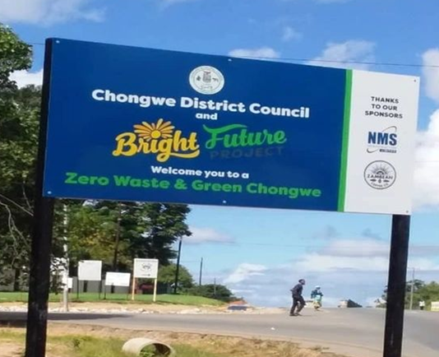
Zambia Zero-Waste Four WTEG Power Plants
The government of Zambia would provide to Alset Power Company 2,000 tons per day, 365 days per year of MSW to be processed with our new Zero-Waste WTEG power plants of which there would be four (4) WTEG power plants. Siemens or a Siemens subsidiary will engineer, provide procurement and construct all five WTE gasification power plants in Zambia and provision of USD $350 million will be arranged through our Private Banks. The four WTEG power plants will be built, operated and maintained by Siemens O&M and local professionals will be hired for the jobs.

Slide 5
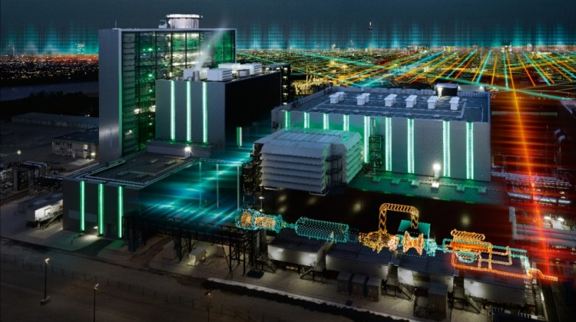
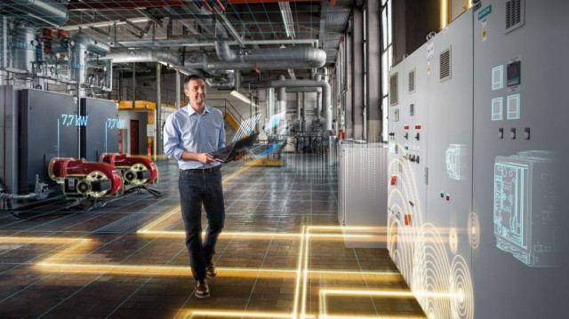
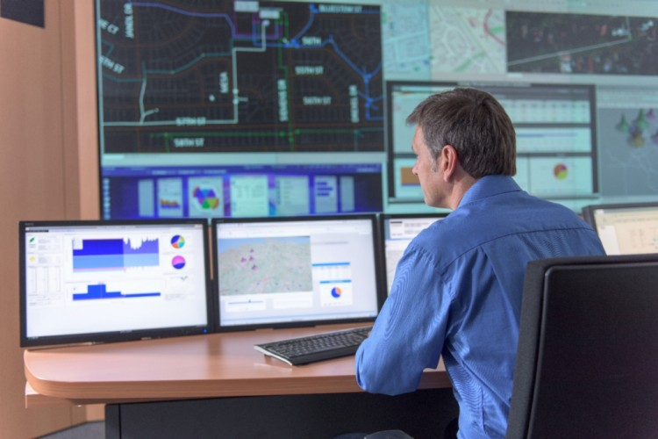
Siemens our chosen EPC company will build the plants – they built the plant in Kentucky USA and Globally have built over 1,000 Power Plants. Development programme underway in Mexico, Kenya, Ghana & Nigeria.

Slide 6
Zambia Zero-Waste Four WTEG Power Plants – Government to have 10% shareholding in each plant – revenue generation
Each of the four Zero-Waste WTE gasification power plants will be built in strategic locations around Zambia so as to reduce transportation costs, gas emissions and wear and tear on the streets and roads. Former projects introduced to Zambia government allowed for only one large incinerator which would not provide these same benefits.
6

Slide 7
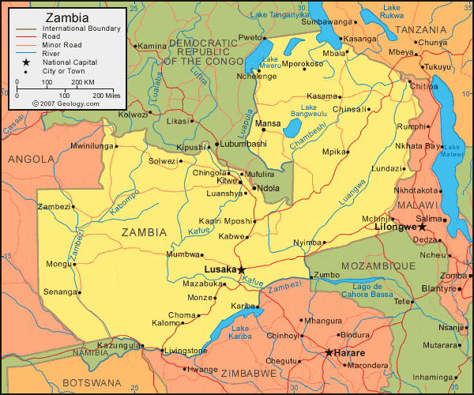
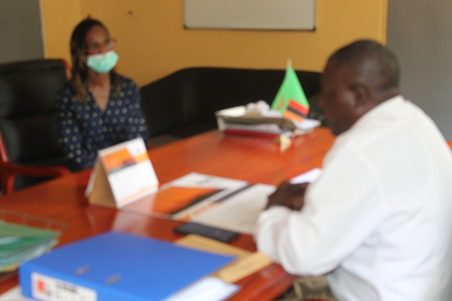
Zambia Zero-Waste Four WTEG Power Plants – Five sites located
Because Alset Power builds only 500 tons per day of MSW power plants, we can locate our Zero-Waste WTEG power plants around the cities so that the waste collection vehicles or garbage trucks can reduce the distance they travel by as much as 50% thereby reducing the wear and tear on the vehicles as much as 50% and save on gasoline usage and subsequent pollution associated with the vehicles. All collection trucks will be equipped with a GPS device in order to track the location of the trucks and to develop more efficient routes and collection patterns 800 jobs created.
7

Slide 8
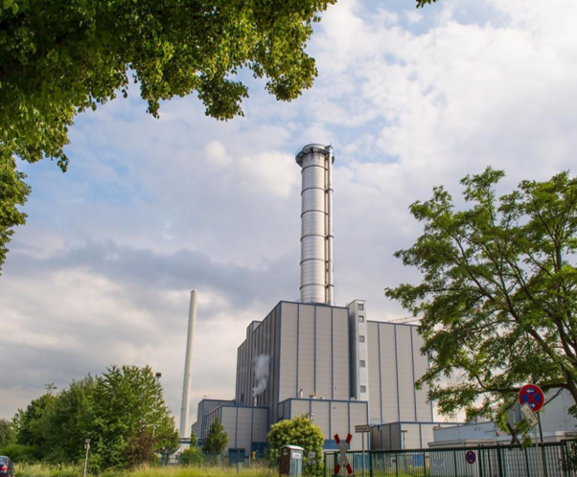
Zambia Zero-Waste Four WTEG Power Plants
Previous proposals to Zambia allowed for the incineration of waste which always provides a ten percent or more residue after the incineration process. This residue is highly toxic to the environment and as such would never comply with the Zambian Clean Air Act. The toxic air emissions spew pollutants into the atmosphere which include dioxins and furans which are harmful to breathe. The dioxins and furans are also discharged within the fly-ash.
Alset Power Company provides a Zero-Waste gasification technology that is the first of its kind that does not allow harmful dioxins into the atmosphere or the ash. The ash that remains after the process is 100% inert and contains no harmful dioxins.
8

Slide 9
Zambia Zero-Waste Four WTEG Power Plants
Alset Power Company will provide to each of the four WTEG power plants state-of the-art monitoring software that will monitor in real-time all WTEG power plant emissions. We are happy to set up monitors in your DENR office so that the Department of the Environment can effectively see first-hand the levels of various particles and gases that are emitted into the air from each of the five stacks. No other company has proposed to share this information directly with the government in this manner. The reason that we do this is because we have nothing to hide, and we are very proud of the technology that we have presented for development in Zambia.

Slide 10
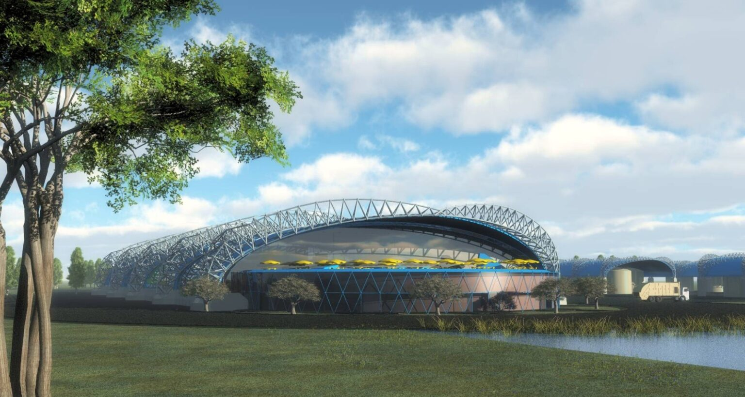
The New Waste plant (s) for Zambia & Educational Centres, working with the Bright Future Project partner

Slide 11
Zambia Zero-Waste Four WTEG Power Plants
Alset Power Company will reduce your landfill carbon footprint by 50%. Our process eliminates the methane gas which is another 50% of the gas emitted by most landfills. Each WTEG power plant is built on approximately 6 acres of land. Our five WTEG power plants will occupy only about 30 acres of land total compared to hundreds of acres needed by landfills.
Another reason for the extra land is so that Alset Power Company can build greenhouses to grow fresh produce for the local markets. The plants absorb the CO2 and convert it to oxygen, thus making the Zero-Waste power plants 100% earth-friendly and environmentally qualifies for carbon credits internationally.
11

Slide 12
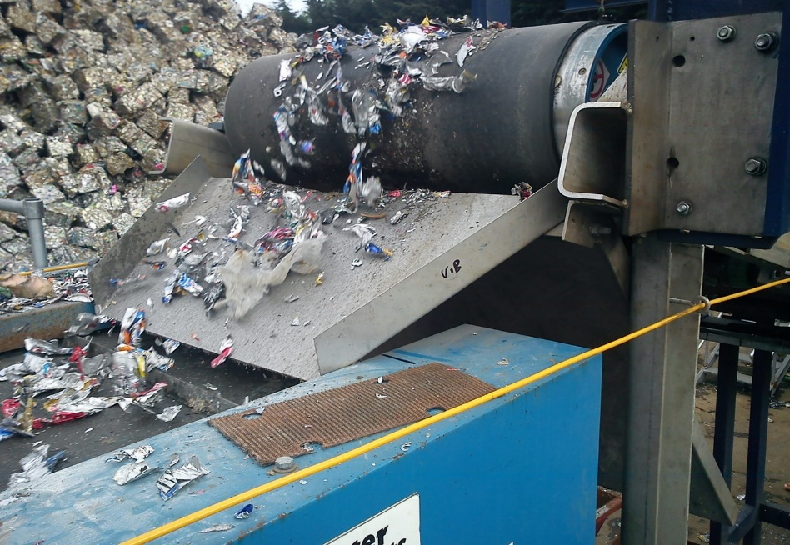
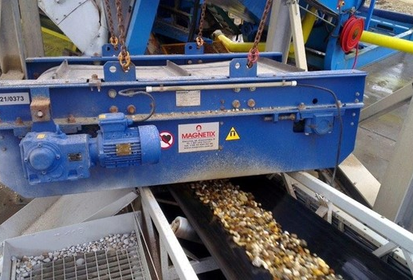
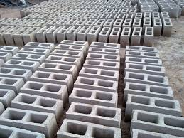
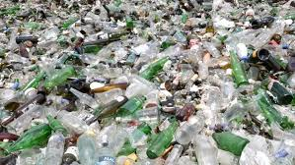
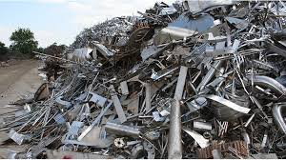
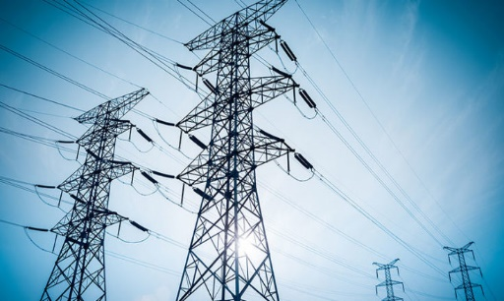
Zambia Zero-Waste Four WTEG Power Plants
The Zero-Waste WTEG power plants will process all toxic waste, household waste, hospital waste, rubber tires, plastics, metals, furniture, paper, glass, organics, etc. All ferrous and non-ferrous metals are removed in the process and the remaining glass is crushed. The ash and crushed glass are combined with additional materials to make concrete, thereby eliminating the need for landfills.

Slide 13
Zambia Zero-Waste Four WTEG Power Plants
The technology that we use is gasification that is used to produce heat for boilers that drive power turbines to produce electricity. Because we combine the process with co-generation (combined-cycle) our hybrid technology will produce approximately 18 MW per each 500 tons of MSW per day for each Zero-Waste WTEG power plant totaling 72MW.
Approximately one megawatt one electricity is parasitic usage.
13

Slide 14
Zambia Zero-Waste Five WTEG Power Plants
Zambia will provide to Alset Power Company a 25-year concession to process 2,000 tons per day of MSW. With the understanding that the concession can be renewed for an additional ten years. Zambia agrees to pay a tipping fee of $10.00 if possible. or its equivalent Zambia currency rate per dollar per ton of MSW processed by Alset’s Zero Waste WTEG power plants.
The Zambia Power utility company will agree to sign a formal power purchase agreement (PPA) that would allow for payment of $0.10 cents or its equivalent Zambian currency to a dollar rate for each kilowatt hour of electricity produced by the WTEG power plants built by Siemens/Alset Power Company. Zambia would receive a negotiable 10% of the profits or more of the combined projects for the term of the concession and Alset Power Company will receive the remaining negotiable 90% of the profits of the venture.
14

Slide 15
Zambia Zero-Waste Four WTEG Power Plants
Alset Power Company’s Zero-Waste WTE gasification technology will virtually eliminate the need of future waste landfills in Zambia. The Zero-Waste WTEG power plants will eliminate the ultimate contamination of ground water caused by landfills. Our WTEG power plants finally eliminate the vermin, germs, diseases, deaths and odors associated with garbage landfills because each of our projects stores all of the MSW inside a building which maintains a negative air pressure.
15

Slide 16
Zambia Zero-Waste Four WTEG Power Plants
For each 500 tons of MSW per day WTEG power plant built, Alset Power Company will create more than 100 full-time jobs for local Zambians. This will certainly benefit the economy as we are expecting to create more than 800 full-time jobs with the completion of these projects.
Many of the waste pickers at Landfill sites can be paid to collect waste and tyres and bring it to the waste plants.
16

Slide 17
Zambia Zero-Waste Four WTEG Power Plants
Alset Power Company will hire hundreds of people to clean up the sidewalks and streets throughout Zambia and will pay people an incentive and possibly rice-for-waste that would go to people that bring garbage or waste to certain collection points that would be strategically located throughout Zambia. The idea is to provide food for people who are without jobs or who do not have a means to obtain food and provide a benefit to the country at the same time.

Slide 18
Zambia Zero-Waste Four WTEG Power Plants
Alset Power Company will also purchase or have built special gas or electric rickshaw tricycles that would be employed to collect garbage and waste from sidewalks and streets throughout Zambia. Special collection depots would be set up in approved areas around Zambia. All these rickshaw vehicles will be monitored with a GPS device to determine the efficiency of the work to be done.

Slide 19
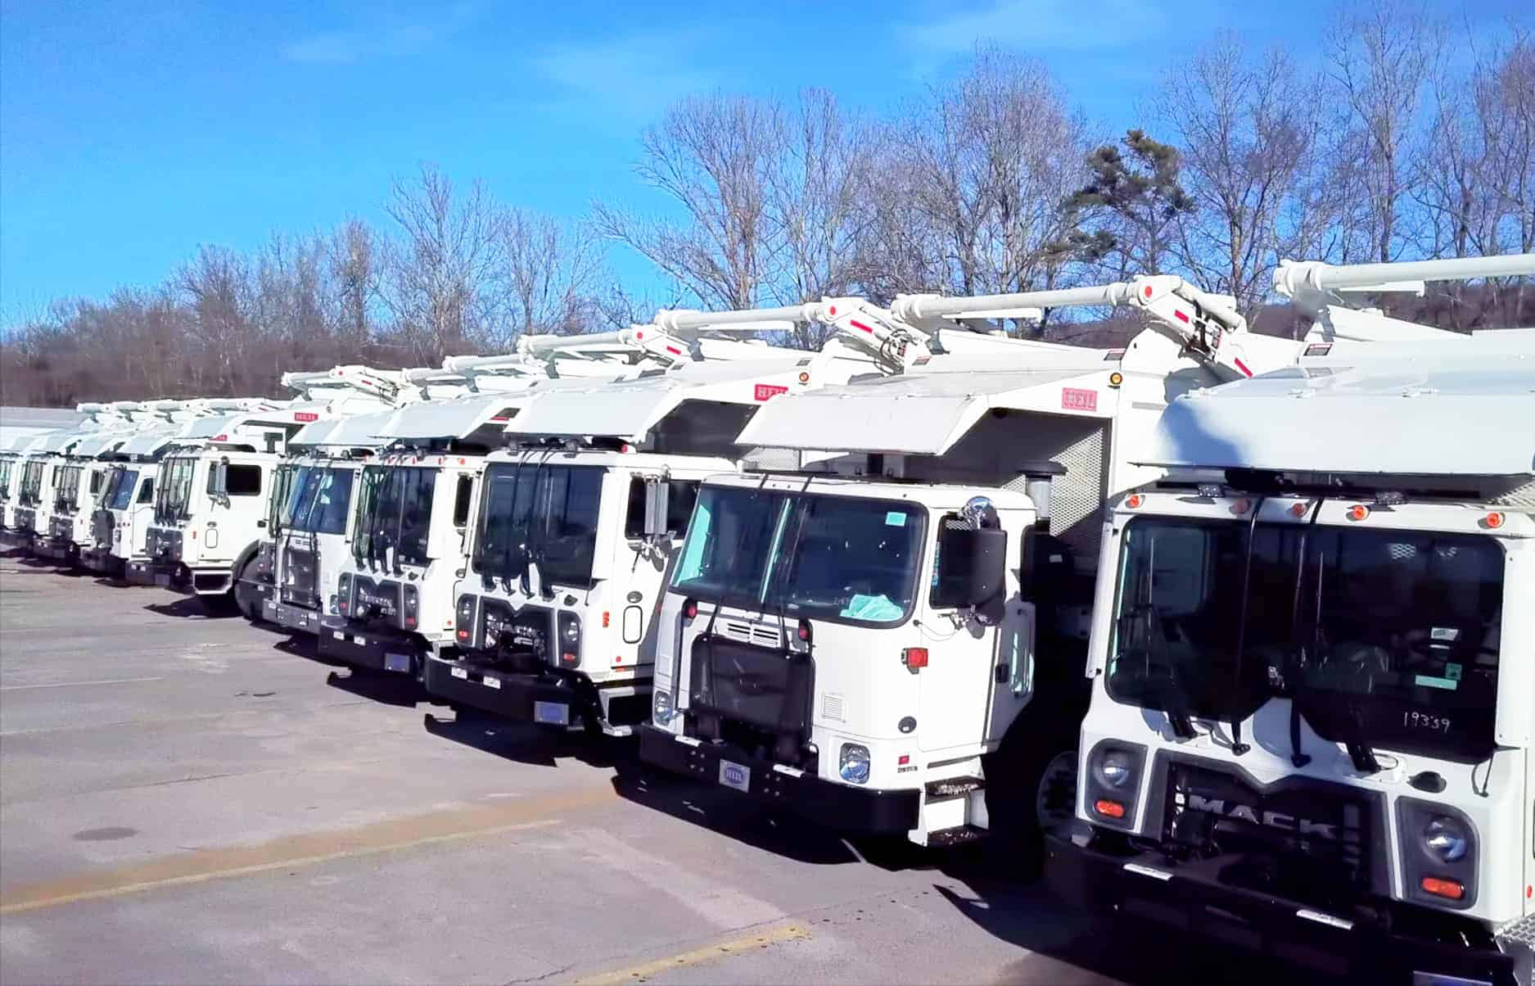
Zambia Zero-Waste Four WTEG Power Plants
Alset Power Company would provide 200 additional Heil garbage trucks & 500 Gas-powered Rickshaws to collect the MSW (700 driver jobs) and provide dumpster containers in neighborhoods in which to deposit the household waste. The numbers of which would be negotiated with Zambia.
19

Slide 20
Zambia Zero-Waste Four WTEG Power Plants
The anticipated Waste-to-Energy (WTE) venture with Zambia and Alset Power Company, Inc. will comply with all national guidelines and with DENR policy objectives with regard to waste management. Alset Power Company shall insure the proper disposal of domestic, commercial and hospital wastes through the development of a waste disposal program and operation of disposal sites and transfer stations (if necessary) and related infrastructure. The Zambian government is responsible for the collection and transport of garbage.

Slide 21
Zambia Zero-Waste Four WTEG Power Plants
The proposed waste management project between Zambia and Alset Power Company will be structured as a build-own-operate (BOO) project, with the understanding that Alset Power Company will continue to operate the Zero-Waste power plants for the duration of MSW availability following the start of operation of each Zero-Waste Power Plant.
21

Slide 22
Zambia Zero-Waste Four WTEG Power Plants
Because sanitary landfill sites currently in use by Zambia will be virtually eliminated due to the establishment of WTEG power plants in strategic locations around Zambia, existing disposal facilities will eventually be eliminated. The government of Zambia will work closely with Alset Power Company to locate and site 5 to 6-acre industrially zoned sites on which to build each of the four WTEG power plants. All sites will be near electric distribution lines with sufficient capacity to transmit the electricity produced by each of the WTEG power plants. Additionally, each of the five 6-acre sites will be located to provide convenient access for the waste collection trucks from the main streets and highways.
22

Slide 23
Zambia Zero-Waste Four WTEG Power Plants
The project also includes the construction of a building block manufacturing unit for fly ash reuse, and other ancillary facilities such as monitoring systems, administration buildings, scale houses, electric distribution lines, utility systems, among others.

Slide 24
Zambia Zero-Waste Four WTEG Power Plants
Zambia also commits to deliver 2,000 metric tons of MSW per day, to acquire the right-of-way (“ROW”) for access roads and other utilities such as electric distribution lines, and to acquire the project site of the facility in case expropriation is required. Costs of acquisition shall be to the account of Alset Power Company.
24

Slide 25
Zambia Zero-Waste Four WTEG Power Plants
The government of Zambia agrees to work closely with Alset Power Company in obtaining the required financing from the International Bank for the funding of said projects by supporting the signing off on the funding documents for the projects by the Minister of Finance – this signing off is still to be done following feasibility studies being completed.
25

Slide 26
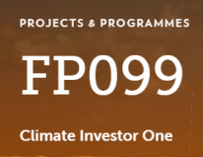
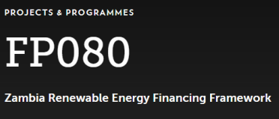
Our Private Bank or Green Climate Fund - Providing financing to develop renewable energy projects in regions with power deficits to reduce energy costs and CO2 emissions.
Our Senior staff have experience of Project Management and delivery of Intergovernmental Renewable Energy funded projects. A major constraint in clean energy investment is a lack of early-stage project financing, combined with insufficient domestic and overseas financing to support the creation of domestic renewable energy markets at scale. To overcome this COP26 funding mechanisms can now assist Zambia.
Zambia, in 2017 benefited from the Green Climate Fund to support the Feed-In-Tariff programme. Climate Investor One (CIO) is a blended finance facility. The first component of this programme is a development fund, which provides loans in the early stage of a project life cycle such as Feasibility study. The second component, a construction equity fund, will meet up to 75 percent of total construction costs in tandem with the project sponsor. Compared with conventional project financing, CIO removes the need for complex multi-party financing structures, with the potential to thereby reduce the time and cost associated with delivering renewable energy projects. We will also link into FP080 programme as required.
$350 million waste plants & $600million solar farms with battery storage – including Feasibility studies total is $937 million
(two separate applications – one waste, one solar)
The programme / project has an estimated lifespan of 20 years.

Slide 27
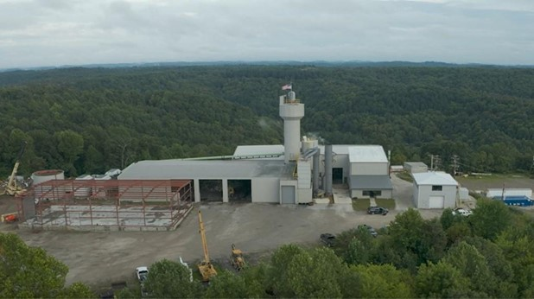
Zambia Zero-Waste Four WTEG Power Plants
The Zero-Waste-to-Energy-Gasification power plant project (4 units) will cost approximately $350 Million Dollars to complete. The dollar rate at the date of final project approval shall prevail for its Zambia currency equivalent. This amount will not include the cost of waste collection trucks, waste collection rickshaws or any other benefits to the country unless requested.
27

Slide 28
Zambia Zero-Waste Four WTEG Power Plants
Each of the five (4) WTEG power plants produces 18 MW of electricity. The total electricity production for the disposition of 2,000 tons per day of MSW for Zambia will be approximately 72 MW. Under the terms of the agreement, Zambia will purchase all of the electricity produced by the Alset Power Company WTEG power plants.
The Technical Group of the Office of the President of Zambia will coordinate with the offices of the Green Economy, Department of Energy (DOE) and Energy Regulatory Commission (ERC) for the approval of the Power Purchase Agreement (PPA). Technical Group will also coordinate with Zambia Electricity Generating Company (ZESCO) for the location of Tapping Points of the Power Lines for the WTEG Power Plants of Alset Power Company.
28

Slide 29
Zambia Zero-Waste Four WTEG Power Plants
Alset Power Company will provide third party testing results to provide direct evidence that the technology used in the WTEG power plants to be provided will fully comply with the Zambia Clean Air Act and will be monitored 24/7 in real time with results provided to the offices of the Department of Environment and Natural Resources.
29

Slide 30
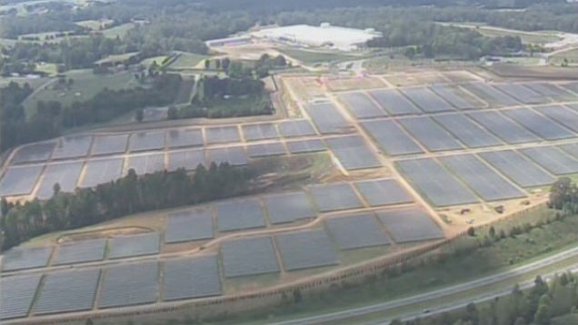
Assisting Zambia with Renewable Energy
We have been pioneering Solar Farm development in Africa since 2012, also Alset Power Company Inc have built two 1,000MW Solar Farms in Chile. Alset Power Company Inc & PSECC Ltd have developed the “Resource Ownership” concept – whereby a City, Town, County or State Council can take ownership over the Natural Resources in their area e.g. Waste, Solar Radiation for Solar Farms. Biomass Plants, Solar PV for homes and Water & Wind Turbines.
We are also proposing a 500MW Solar Farm development programme for Zambia.

Slide 31
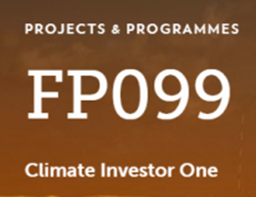
Next Steps – application for funding – we will first contact our Private Banks for funding
$350 million waste & $600 million solar – including Feasibility studies total is $1.3 Billion
Then we will look at COP26 funding - To be eligible - Fund considers project concept notes and funding proposals from Accredited Entities (both public and private), which are supported by National Designated Authorities. The Fund’s current list of accredited entities is available at the link below. Is the Green Economy Ministry interested to pursue with us to obtained Feasibility Study & main project funding from the COP26 fund: Accredited Entities | Green Climate Fund:
https://www.greenclimate.fund/about/partners/ae
Preferred partner would be the accredited entity - Development Bank of Zambia
https://www.greenclimate.fund/ae/dbz
Please also see the list of the Fund’s National Designated Authorities for more information about the Fund’s national government partners across the world:
http://www.greenclimate.fund/partners/countries/nda-directory
Preferred Fund’s National Designated Authority to use is Zambia – FP080
https://www.greenclimate.fund/countries/zambia#contact
We are currently reaching out to the relevant Accredited Entities and National Designated Authorities. Once we have obtained their buy-in/support, they would reach out to us with a concept note or funding proposal – assistance from Green Economic Ministry is required.
To start, the Ministry could provide a Mandate letter to us and make initial contact with both FP080 & FP099 at the Green Climate Fund. Beneficial if you can also source five or ten sites for solar farms in Economic or Industrial Zones. Zambia Waste plants Project Profile document has been produced and is available on the “About” page of the www.wtezambia.com website.

Slide 32
Please contact Ngozika Victoria Onyekwelu at The Bright Future Project for further details.
Email: The Bright Future Project info.thebrightfutureproject@gmail.com; Tel: +260 96 4221770
Mr Alan Brewer MSc. Environmental Engineering
Senior Vice President
Alset Power Company Inc
245 East 93rd Street, 9th Floor,
New York, N.Y. 10128
917-213-9622
866-624-3997
www.alsetpower.com
(Password on request)
President Mr Avery Knox
Website: wtezambia.com
Assistance given by PSECC in the UK www.psecc.co.uk
Video of USA plant –
https://mega.nz/file/M8gmhTCa#7IfxSscL48M43k_FQJTdEiWdBEHd9reDnOEB61myeY
32

