Slide 1
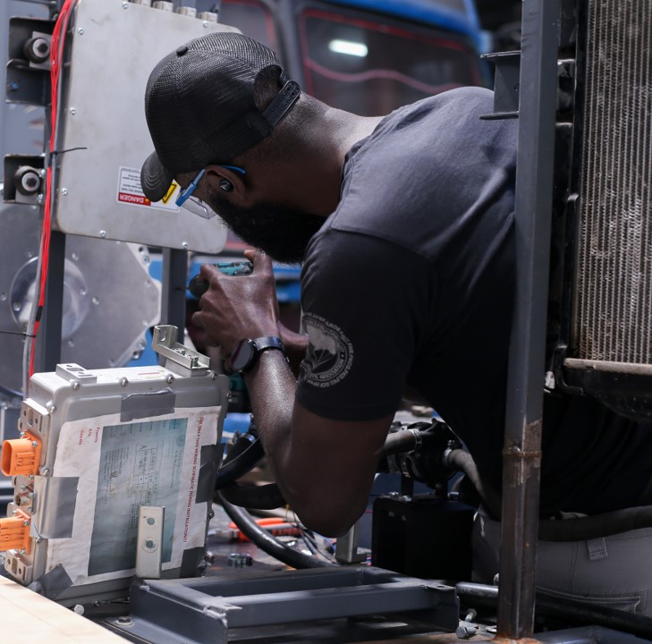
Manufacturing Africa
This programme is funded by UK aid from the UK government; however, the views expressed do not necessarily express the UK government’s official policies.
Text

Slide 2
Manufacturing Africa addresses two of Africa’s key challenges
A growing labour force…
100%
2x
18 million
increase in population by 2050
increase in urban population by 2050
new jobs needed a year until 2035
…and an underdeveloped manufacturing sector
low manufacturing productivity
struggle to move into high-value services

Slide 3
Manufacturing Africa Programme Overview
Programme goal Contribute to economic transformation in Africa by attracting £1.2 billion of foreign direct investment and create 90,000 jobs in the manufacturing sector
Ethiopia
Funding UK Government, Foreign, Commonwealth and Development Office (FCDO)
Duration 7 years (2019-2026)
Focus sector Manufacturing
Senegal
Nigeria
Kenya
Implementing consortium McKinsey & Company, BDO, TechnoServe, Reformatics, Steward Redqueen
Rwanda
Support provided Transaction facilitation for investors and companies Technical assistance to governments and investment promotion agencies

Slide 4
Supporting investment into Africa across brownfield and greenfield
TRANSACTION FACILITATION
What we do
Who we work with
What support we provide
Non-exhaustive
Offer neutral investment advisory services to reduce the risk, cost and deal time of manufacturing transactions
Feasibility
Assess markets
Commercial review
Review business cases
Local manufacturing companies
Permits
Clarify regulation
Support stakeholder engagement
Provide market mapping and stakeholder engagement support
Financing
Develop investment memos
Financial analysis and vendor assistance
Enhance financial models
International MNC
Identify investors
Capital structuring
Commercial and financial analysis
Operational
Facilitate linkages e.g. identify suppliers and off-takers
ESG gap analysis and minimum policy adherence
Development impact enhancement across (environmental, gender, social, and governance)
Buyside Investors
Providing advice on governance structures and processes
High level 100 day plan support
Development impact
support to enhance ESG impact on local economies
Industrial parks and manufacturing enablers

Slide 5
MA has supported a wide range of investment opportunities
TRANSACTION FACILITATION
AS OF JAN 2022
Deal value ($M)
Deals supported or in progress
Selected examples of transactions supported
8 deals reached financial close including:
75
86
8
90
Steel company looking to set up a green steel semi-finished product plant
Local conglomerate looking to setup an investment platform in FMCG goods
Steel company looking to expand its operations
deals
20
$2bn+
70
5
Chemicals company producing hygiene and consumer related chemical inputs and end products
Eco-industrial park looking to attract apparel and agri-processing tenants
Local fruit pulp producer looking to set up a new facility to serve the regional market
Potential FDI
15
6
6
30,000+
Local pharmaceutical company looking to upgrade and expand domestic operations
Solar home system new venture to Manufacture and assembly of components for the SHS and mini-grid industry
Dairy manufacturer looking to expand and diversify business into yoghurt and cold chain logistics
Potential direct jobs to be created

Slide 6
Supporting the environment for investment and developing sectors
BACK-UP
What we do
Who we work with
What support we provide
Provide COVID-19 response and recovery support to the manufacturing sector
Governments
Capacity building
Provide assistance and training to investment promotion agencies, strengthening governments’ capacity to profile investment opportunities and facilitate deals
Investment promotion agencies
Policy reform
Support policy changes at the sector level to remove obstacles to investment and attract investors
Strategic investment promotion
Donors
Run sector-wide strategic initiatives to help groups of manufacturers improve project feasibility

Slide 7
Contact us:
For more information visit: www.manufacturingafrica.org
info@manufacturingafrica.org

